Slide 1














HOME
PRESCRIBER
PATIENT
RESOURCES
What is
JINARC® RMP?
Prescriber
Requirement
Patient
Requirement
What is ADPKD?
Full prescribing information available from Tolvaptan (Jinarc®) Package insert
Tolvaptan (Jinarc®) [Package Insert]. Tokushima, Japan; OPC; December. 2022.

Slide 2
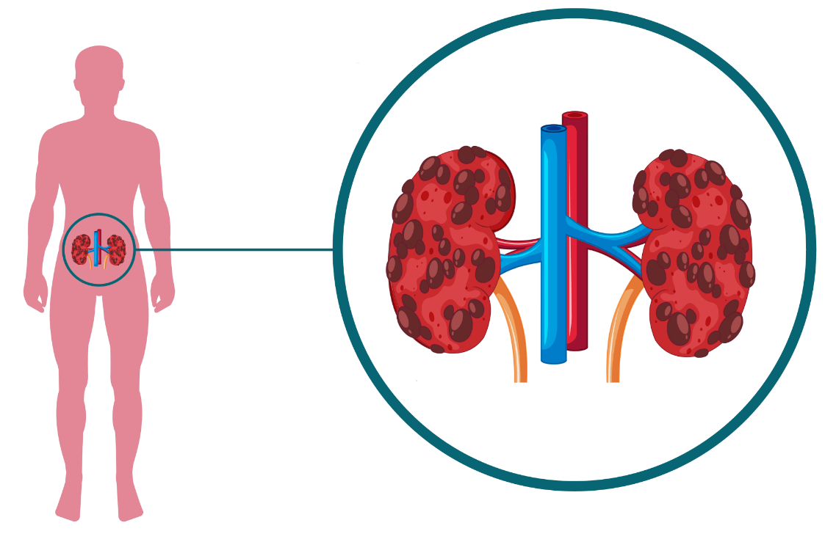
What is
JINARC® RMP?
Prescriber
Requirement
Patient
Requirement
What is ADPKD?
Autosomal Dominant Polycystic Kidney Disease (ADPKD) is a hereditary & progressive disease characterized by gradual enlargement of cysts in both kidneys leading to renal insufficiency, or reduction in kidney function, ultimately leading to End-Stage Renal Disease (ESRD).
TOP

Slide 3
Prescriber
Requirement
Patient
Requirement
What is ADPKD?
What is JINARC® RMP?
The JINARC® RMP (Risk Management Program) is designed to manage the risk of serious and potentially fatal liver injury associated with using JINARC®, and the RMP ensures that the benefits of using JINARC® outweigh its risks.
There have been reports of acute liver failure requiring liver transplantation in patients with ADPKD on the post-marketing ADPKD experience. Discontinuation in response to laboratory abnormalities or sign or symptoms* of liver injury can reduce the risk of severe hepatotoxicity.
* These symptoms may include: fatigue, nausea, abdominal discomfort, fever, rash, yellowing of the skin or eyes, dark urine, or itching.
TOP

Slide 4
What is
JINARC® RMP?
Patient
Requirement
What is ADPKD?
FOR PRESCRIBERS
To prescribe JINARC®, healthcare providers need to follow these steps:
Complete a one-time certification process by passing the Prescriber Knowledge Assessment.
Counsel patients and conduct baseline liver testing before enrolling them in the RMP, then write the prescription.
Continuously monitor patients, conducting liver testing at specific intervals* during the first 18 months of treatment, and then every 3 months thereafter.
Prescriber Knowledge Assessment
* These intervals include 2 weeks and 4 weeks after your first dose and monthly for the first 18 months of treatment.
TOP

Slide 5
What is
JINARC® RMP?
Prescriber
Requirement
What is ADPKD?
FOR PATIENTS
To receive JINARC®, patients need to follow these steps:
Understand risks associated with JINARC®.
Enroll in the RMP by calling JINARC® Patient Support Team.
Complete baseline liver testing before taking your first dose, and then at specific intervals* during the first 18 months of treatment, and every 3 months thereafter.
* These intervals include 2 weeks and 4 weeks after your first dose and monthly for the first 18 months of treatment.
TOP

Slide 6



HOME
PRESCRIBER
PATIENT
RESOURCES
What is the importance of JINARC® RMP?
How to become a certified prescriber of JINARC®?
How do I enroll a patient in the JINARC® RMP?
Once a patient is on JINARC®, how often should I monitor patients?
How should I report liver adverse events?
BE A CERTIFIED JINARC® PRESCRIBER
Full prescribing information available from Tolvaptan (Jinarc®) Package insert
Tolvaptan (Jinarc®) [Package Insert]. Tokushima, Japan; OPC; December. 2022.

Slide 7


HOME
PRESCRIBER
PATIENT
RESOURCES
What is the importance of JINARC® RMP?
TOP
Purpose:
The JINARC® RMP aims to reduce the risk of severe and potentially fatal liver injury associated with the use of JINARC®.
This is done by:
Educating healthcare providers about:
the risks of using JINARC®,
the importance of baseline & periodic monitoring, and
the need to counsel patients on the risks of using JINARC®.
Ensuring they follow the monitoring requirements.
Informing patients about the risks and monitoring requirements.
Additionally, all patients using JINARC® are enrolled in a JINARC® Patient Support Database to further support long term safety of JINARC®.

Slide 8

HOME
PRESCRIBER
PATIENT
RESOURCES
How to become a certified prescriber of JINARC®?
TOP
Review the educational materials on JINARC®
Prescribing Information
Prescriber Guide
2) Pass the Prescriber Knowledge Assessment. Once you fulfill the requirement, the JINARC® RMP will send the certification to your registered e-mail address.
Download File
Download File
Take the Prescriber Knowledge Assessment

Slide 9



HOME
PRESCRIBER
PATIENT
RESOURCES
How do I enroll a patient in the JINARC® RMP?
TOP
To enroll a patient in the JINARC® RMP:
Counsel the patient on the risks and monitoring requirements using the Patient Guide.
Order and evaluate liver function test (LFT) before the first prescription.
After reviewing patient’s LFT, inform the patient to contact JINARC® Support Team.
Telefax: ‪02-7-576-0257
GLOBE: ‪0917-300-6456 (w/ Viber)
SMART: ‪0999-886-9801 (w/ Viber)
Download Patient Guide

Slide 10

HOME
PRESCRIBER
PATIENT
RESOURCES
Once a patient is on JINARC®, how often should I monitor patients?
TOP
Order and review liver laboratory tests (liver transaminases and total bilirubin) at specific time points after treatment initiation, as follows:
WEEKS
MONTHLY
QUARTERLY
1
2
3
4
1
2
3
4
5
6
7
8
9
10
11
12
13
14
15
16
17
18
1
2
3
4
At 2 weeks and
4 weeks after
treatment initiation
Monthly for the first 18 months of treatment
Every 3 months
thereafter
Assess the patient's liver function and determine the appropriateness of continuing treatment.

Slide 11



HOME
PRESCRIBER
PATIENT
RESOURCES
How should I report liver adverse events?
TOP
To report serious or potentially fatal liver issues, healthcare providers must notify the OPPI-Pharmacovigilance and collect the following information:
Description of event
Patient information
Otsuka product Involved e.g. Tolvaptan (JINARC®)
Primary reporter contact information
OPPI-Pharmacovigilance:
Email: oppi-pv@otsuka.com.ph
Contact number: 0999-8869-910
Safety Information Reporting Guide
Download File

Slide 12
HOME
PRESCRIBER
PATIENT
RESOURCES
What is JINARC®?
Who should not take JINARC®?
How do I enroll in the JINARC® RMP?
What do I need to do while taking JINARC®?
How will I get my JINARC® medicine?
Full prescribing information available from Tolvaptan (Jinarc®) Package insert
Tolvaptan (Jinarc®) [Package Insert]. Tokushima, Japan; OPC; December. 2022.

Slide 13

HOME
PRESCRIBER
PATIENT
RESOURCES
What is JINARC®?
TOP
JINARC® is a medication that is prescribed to adults who have a high risk of rapidly progressing Autosomal Dominant Polycystic Kidney Disease (ADPKD) in order to slow down the decline of their kidney function.
It has not been determined whether JINARC® is both safe & effective for children.

Slide 14




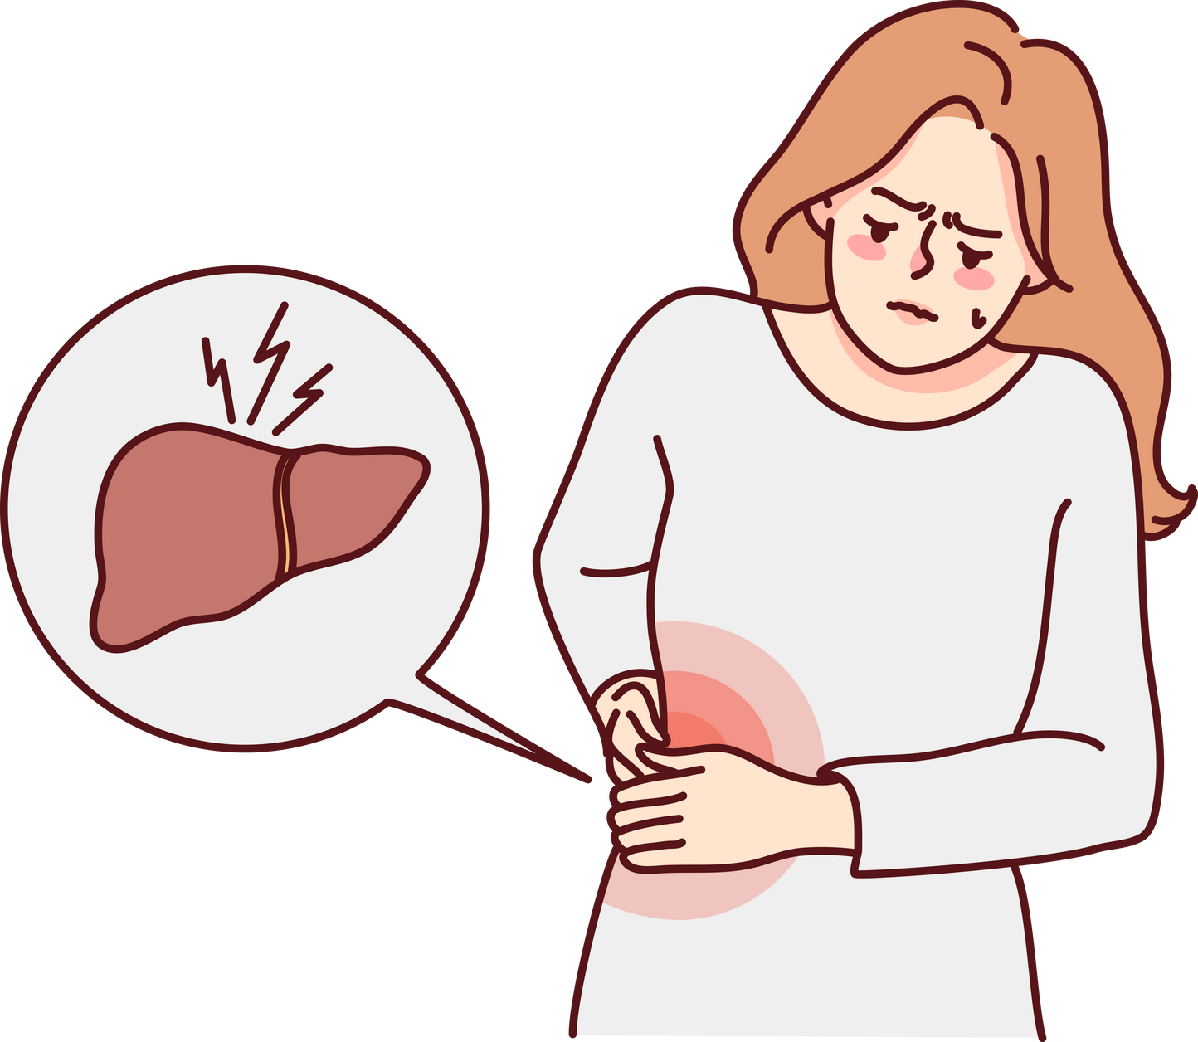



HOME
PRESCRIBER
PATIENT
RESOURCES
Who should not take JINARC®?
TOP
Do not take JINARC®, if you:
have a history
of liver problems*
have high or low sodium levels
are allergic to Tolvaptan
cannot feel thirst or unable to drink
are dehydrated
are unable to urinate
* This excludes those with polycystic liver disease who have liver problems.

Slide 15
HOME
PRESCRIBER
PATIENT
RESOURCES
How do I enroll in the JINARC® RMP?
TOP
To enroll in the JINARC® RMP and start taking JINARC®, you need to do the following:
Agree to undergo Liver Function Test before starting and regularly during treatment to monitor your liver health.
Contact JINARC® Patient Support Team to enroll in the JINARC® RMP
Telefax: ‪02-7-576-0257
GLOBE: ‪0917-300-6456 (w/ Viber)
SMART: ‪0999-886-9801 (w/ Viber)

Slide 16


HOME
PRESCRIBER
PATIENT
RESOURCES
What do I need to do while taking JINARC®?
TOP
To reduce the risk of liver problems while taking JINARC®, your healthcare provider will check your liver function by doing a blood test:
1) Before you start taking JINARC®
WEEKS
MONTHLY
QUARTERLY
2)
1
2
3
4
1
2
3
4
5
6
7
8
9
10
11
12
13
14
15
16
17
18
1
2
3
4
At 2 weeks and
4 weeks after
treatment initiation
Monthly for the first 18 months of treatment
Every 3 months
thereafter

Slide 17


HOME
PRESCRIBER
PATIENT
RESOURCES
How will I get my JINARC® medicine?
TOP
1) Call our JINARC® Patient Support Team and share your Liver Function Test result and prescription.
Telefax: ‪02-7-576-0257
GLOBE: ‪0917-300-6456 (w/ Viber)
SMART: ‪0999-886-9801 (w/ Viber)
2) After you are enrolled in the JINARC® RMP, you can now call to order & fill prescription.
JINARC® is only available from JINARC® RMP

Slide 18



HOME
PRESCRIBER
PATIENT
RESOURCES
Tolvaptan (Jinarc®) Prescribing Information
Download File
Prescriber Guide
Download File
Patient Guide
Download File

Slide 19
HOME
PRESCRIBER
PATIENT
RESOURCES
Prescriber Knowledge Assessment
Name:
Hospital Affiliation:
Specialty:
Email:
PRC License:
Submit

Slide 20
HOME
PRESCRIBER
PATIENT
RESOURCES
Prescriber Knowledge Assessment
In order for you to become a certified prescriber of Jinarc, you need to successfully complete the Prescriber Knowledge Assessment and correctly answer all 8 questions.
START THE ASSESSMENT

Slide 21
HOME
PRESCRIBER
PATIENT
RESOURCES
Prescriber Knowledge Assessment
Question
1
Before starting a new patient on JINARC®, I should:
Read the Prescribing Information and Prescriber Training
Counsel patients about the risk of serious and potentially fatal liver injury associated with JINARC®
Order and review baseline liver function tests
All of the above
A
B
C
D
Reset
Next

Slide 22
HOME
PRESCRIBER
PATIENT
RESOURCES
Prescriber Knowledge Assessment
Question
2
Patients you identify as qualified to receive JINARC® can enroll in the JINARC® RMP in order to be able to receive treatment?
TRUE
FALSE
A
B
Reset
Next

Slide 23
HOME
PRESCRIBER
PATIENT
RESOURCES
Prescriber Knowledge Assessment
Question
3
JINARC® is indicated to reduce kidney cyst growth and slow kidney function decline in adults at risk of rapidly progressing autosomal dominant polycystic kidney disease (ADPKD).
TRUE
FALSE
A
B
Reset
Next

Slide 24
HOME
PRESCRIBER
PATIENT
RESOURCES
Prescriber Knowledge Assessment
Question
4
At 18th month of continuous JINARC® treatment, your ADPKD patient with no history of elevation of liver enzymes (AST, ALT, TBL) has returned for his/her monthly consultation, which is the appropriate course of action?
A
Order the 18th month liver function test, evaluate results of LFT, then proceed to write prescription of JINARC®. Advice patient to her next LFT on the 21st month.
Order the 18th month liver function test, evaluate results of LFT, then write prescription of JINARC®Advice patient to return next month for her LFT.
Advice patient to return for her liver function test on the 21st month, then write prescription of JINARC®good for 3 months.
Advice patient to return after two weeks for her liver function test, then write prescription of JINARC®good for 2 weeks.
B
C
D
Reset
Next

Slide 25
HOME
PRESCRIBER
PATIENT
RESOURCES
Prescriber Knowledge Assessment
Question
5
Patients can take JINARC® and elect not to have blood tests done.
TRUE
FALSE
A
B
Reset
Next

Slide 26
HOME
PRESCRIBER
PATIENT
RESOURCES
Prescriber Knowledge Assessment
Question
6
The primary counseling message I should tell my patients is:
Do not drink alcohol before you take JINARC®
Stop therapy if ALT or AST is >2 times the ULN
There is a risk of serious and potentially fatal liver injury associated with JINARC® and that blood testing and monitoring is required
Patients need to have blood tests every 18 months
A
B
C
D
Reset
Next

Slide 27
HOME
PRESCRIBER
PATIENT
RESOURCES
Prescriber Knowledge Assessment
Question
7
Adverse event/safety information should be reported to?
oppi-pv@otsuka.com.ph
0999-8869-910
www.jinarcrmp.com.ph
Both A & B
A
B
C
D
Reset
Next

Slide 28
HOME
PRESCRIBER
PATIENT
RESOURCES
Prescriber Knowledge Assessment
Question
8
The following are mandatory adverse event/safety information to be reported, except:
FDA Drug Registration Number
Otsuka Product Involved
Patient Details
Adverse Event/Safety Information Details
A
B
C
D
Reset
Next

Slide 29
HOME
PRESCRIBER
PATIENT
RESOURCES
Prescriber Knowledge Assessment
Your Prescriber Knowledge Assessment score is
5
out of 8
Your assessment result:
1
2
3
4
5
6
7
8
RETAKE
REVIEW PRESCRBING INFORMATION
REVIEW PRESCRIBER GUIDE

Slide 30


HOME
PRESCRIBER
PATIENT
RESOURCES
Prescriber Knowledge Assessment
CONGRATULATIONS!
You are now a certified Jinarc® prescriber.
PLEASE SIGN HERE TO COMPLETE THE ASSESSMENT
Reset
Done
We will send your certificate to your registered e-mail address.

